Slide 1
Simulation of a Virtual File System (VFS)
With Multi-user and Multi-Directory
Zongming Li & Juli Yang

Slide 2
Introduction
Virtual File System (VFS)
The Virtual File System (VFS) is an important component in the operating system, which provides a unified abstraction layer for accessing different types of file systems.
VFS can support multiple file systems, such as FAT, NTFS, EXT, etc. This means that no matter what file system the file is actually stored on, user programs can access it in the same way.

Slide 3
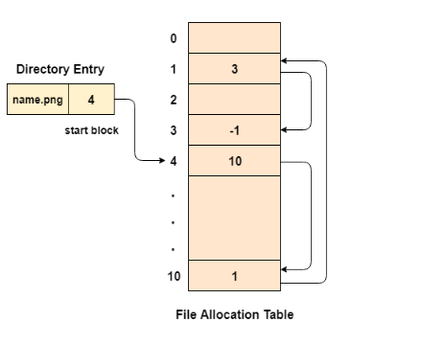
Introduction
File Allocation Table (FAT)
FAT is a file system widely used in early PCs and portable storage devices (such as USB flash drives).
It uses a table to track where files are stored on disk. Each file consists of a series of scattered disk blocks, and the FAT table records the sequence of these blocks.

Slide 4
Project Goals
User Management: Use authentication mechanism
File Operations: Basic file operations such as create, read, delete
Multi-level Directory Management:
Complex file paths
Interactive interface:
Enhance the real operation experience

Slide 5
File System Structure
Multi-User Structure
Register and Log in: Users can register and use the system.
User Accounts: Each user has a top-level directory, which is private.
Multi-Directory Structure
Home Directory: The root for each user.
Subdirectories: Organize files under each user account.
Active Files: Stored as numbered entities (e.g., file0, file1) for easy access and modification.

Slide 6
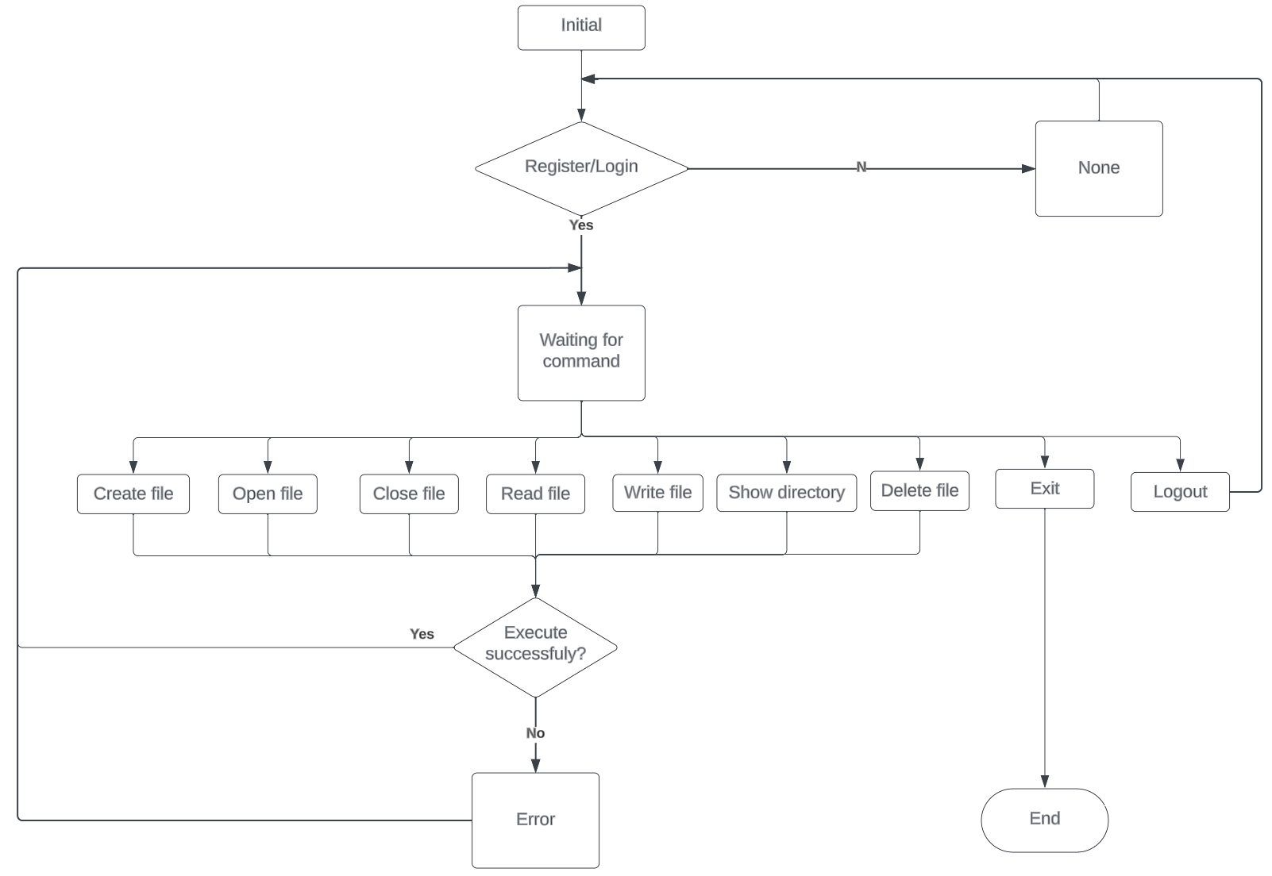
File System Structure

Slide 7
User Management
Registration: How users can register (‘register’)
Login/Logout: User login (‘login [username] [password]’) and logout (‘logout’) mechanisms
User Data: Overview of users’ dictionary with passwords and directories

Slide 8
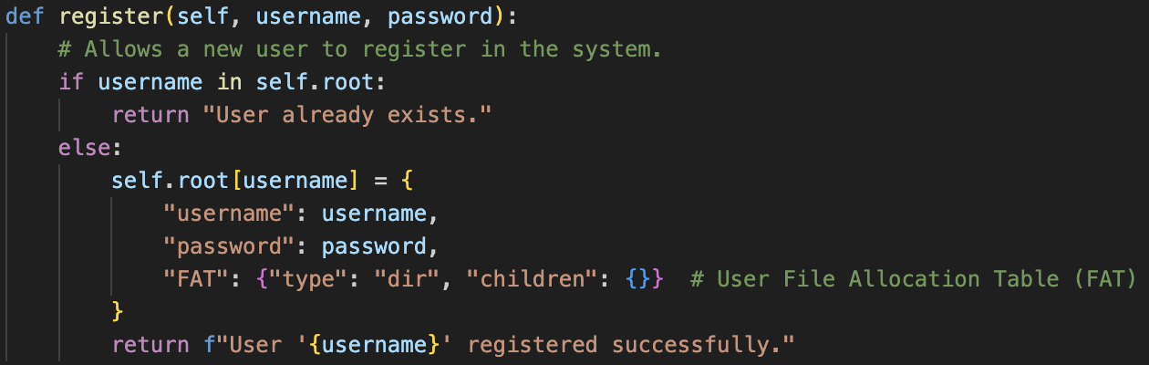
User Management
Registration:

Slide 9
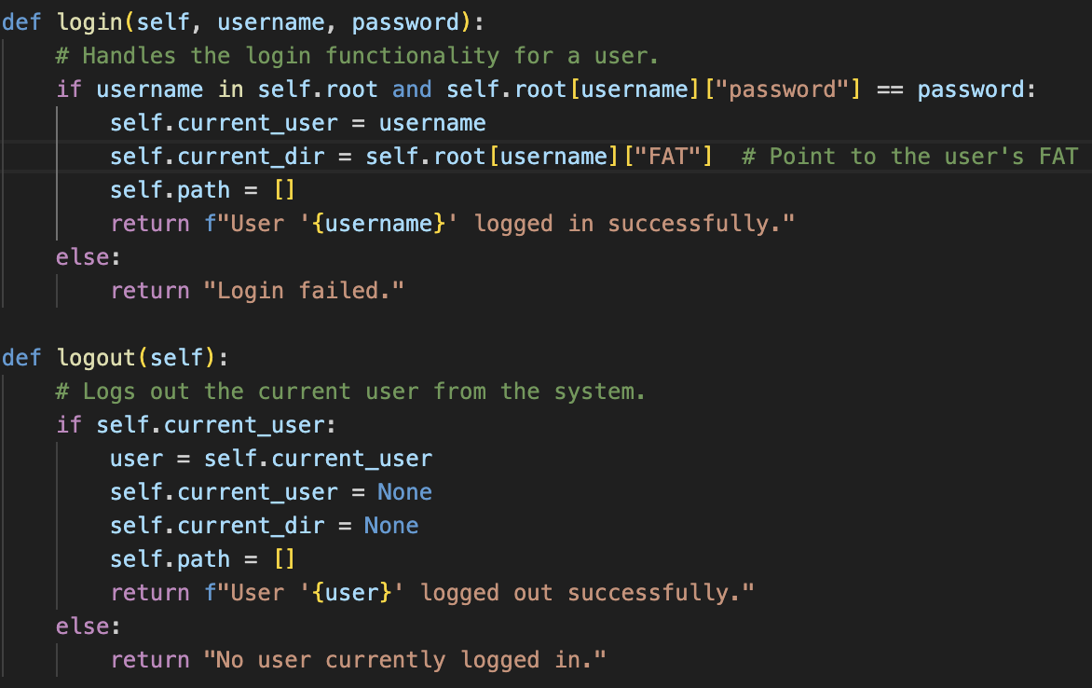
User Management
Login/Logout:

Slide 10
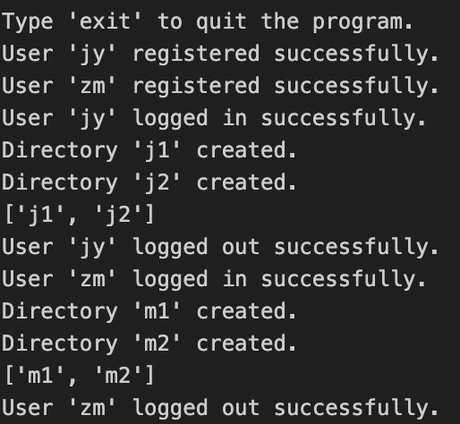
Security and Access Control
Basic User Authentication: Password protection for user accounts
Access Control: User-specific directories

Slide 11
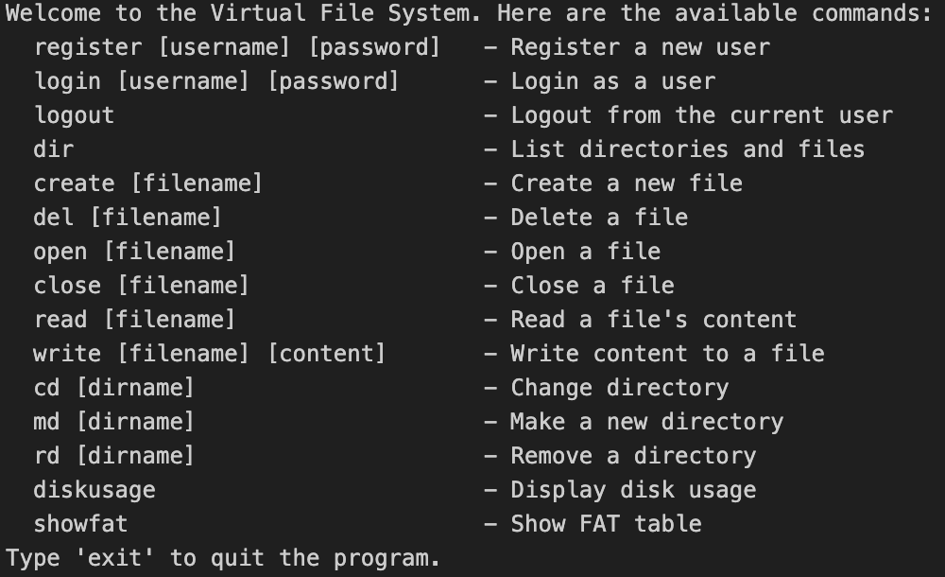
File Operations
Creating Files: ‘create’
Deleting Files: ‘del’
Opening and Closing Files: ‘open’ and ‘close’
Reading and Writing Files: ‘read’ and ‘write’
Listing Contents: ‘dir’
Changing Directories: ‘cd’
Creating and Deleting Directories: ‘md’ and ‘rd’

Slide 12
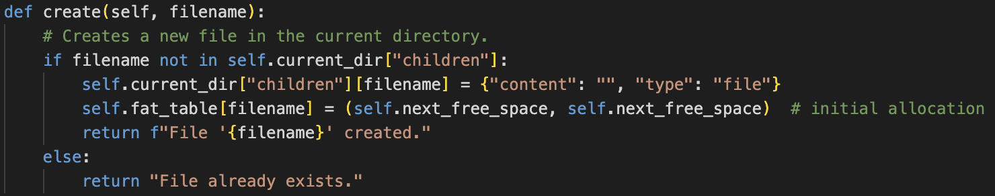
Creating Files
When creating a new file, the system allocates a directory entry for the file in FAT directory entry for the file. The directory entry should record the file name of the new file, the total capacity of the file and the starting location of the file on the disk.

Slide 13
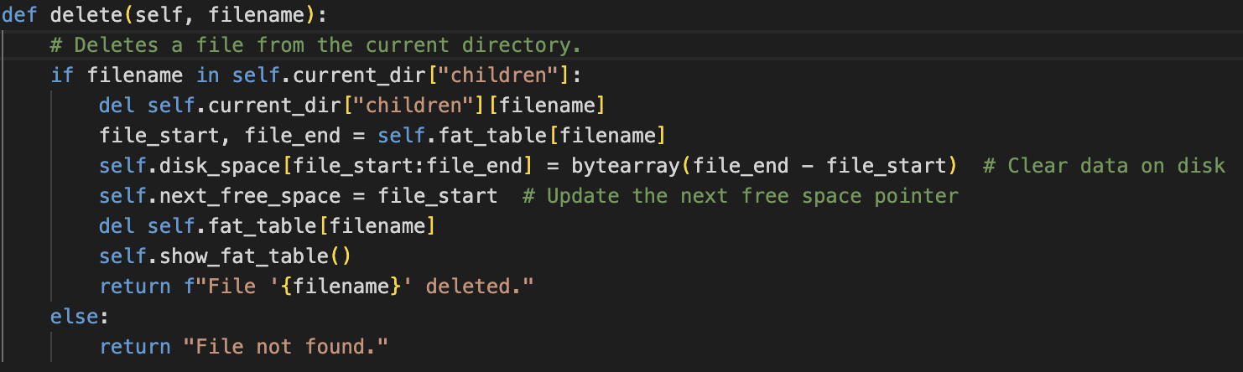
Deleting Files
When deleting a file, the system can delete the node from the file chain table and reclaim the disk space corresponding to the node disk space corresponding to the node.

Slide 14
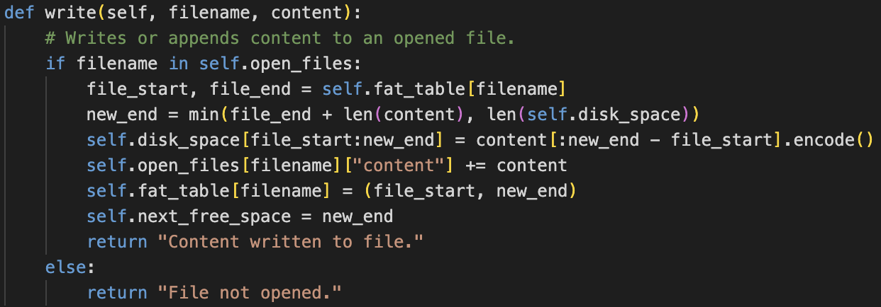
Write Files
The user can write the data to a user-defined file (on disk); the file to be written must be open The file to be written must be open.

Slide 15
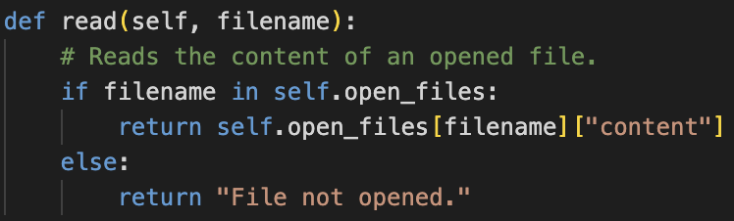
Read Files
The user can read out the data stored in the file; the file to be read must be open.

Slide 16
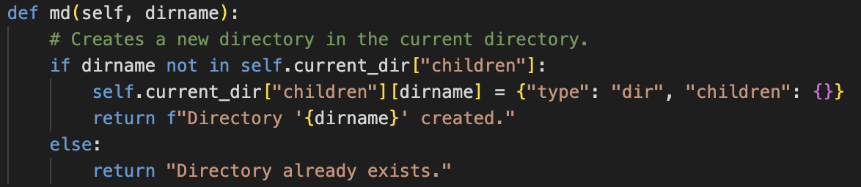
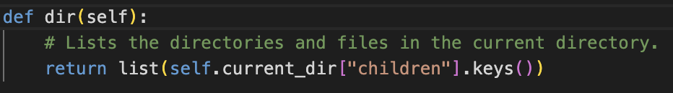
Creating Directories and Listing Contents
Creating directories
Listing contents

Slide 17
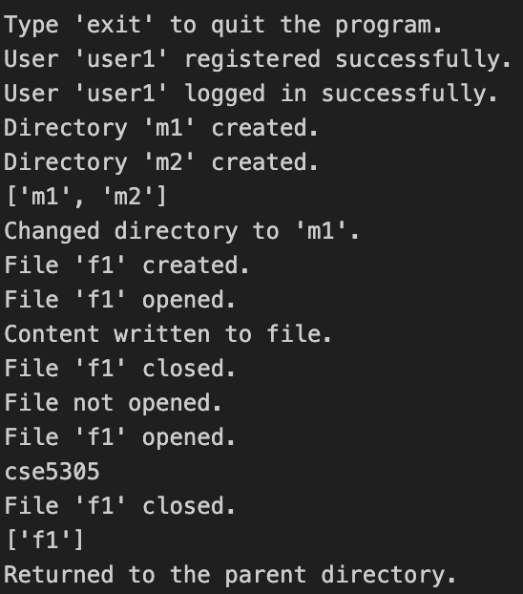

File Operations Example
An example interaction with the VFS might include registering a user, logging in, creating a file, writing to it, and then reading from it, followed by logging out.

Slide 18
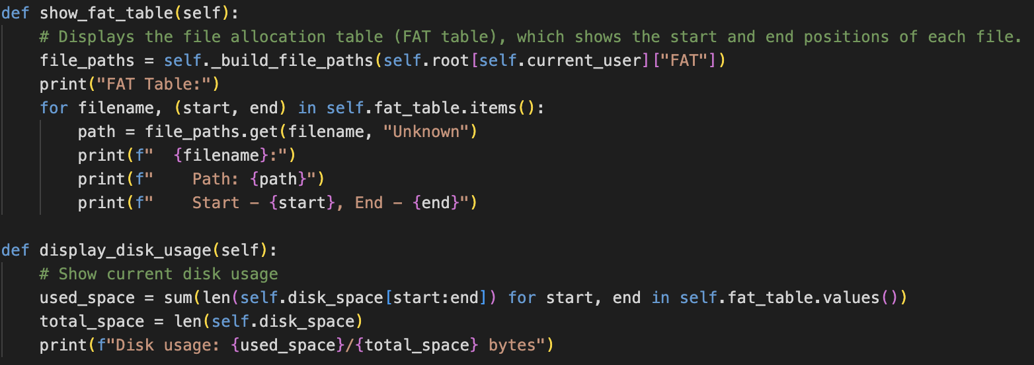
Disk Management and FAT

Slide 19
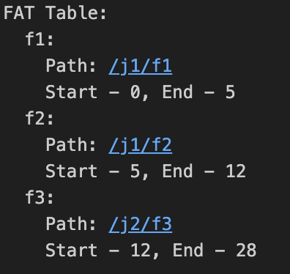
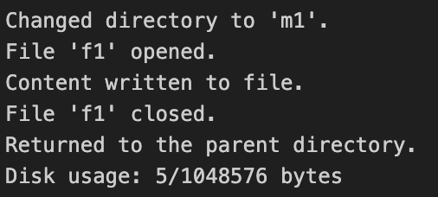
Disk Management and FAT
VFS manages disk space and file allocation using a FAT table. It displays disk usage and manages the allocation and deallocation of space for file storage.

Slide 20
Conclusion
Summary of Features:
Recap of the VFS capabilities
Potential Improvements:
Add the functionalities of shared files.
List more information not just name of the directory, such as last modified time, data size, etc.

